Slide 1
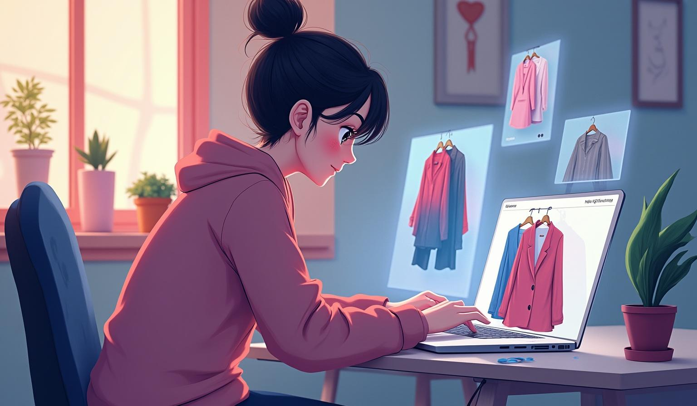
Xerox
Clothing Website Built with Python,html,css and Bootstrap

Slide 2
Introduction
Xerox is a dynamic clothing website developed using Python, HTML, CSS, and Bootstrap. The platform aims to provide users with an intuitive, seamless shopping experience featuring responsive design and efficient backend functionality. This presentation outlines the core elements and innovation behind the Xerox project.

Slide 3
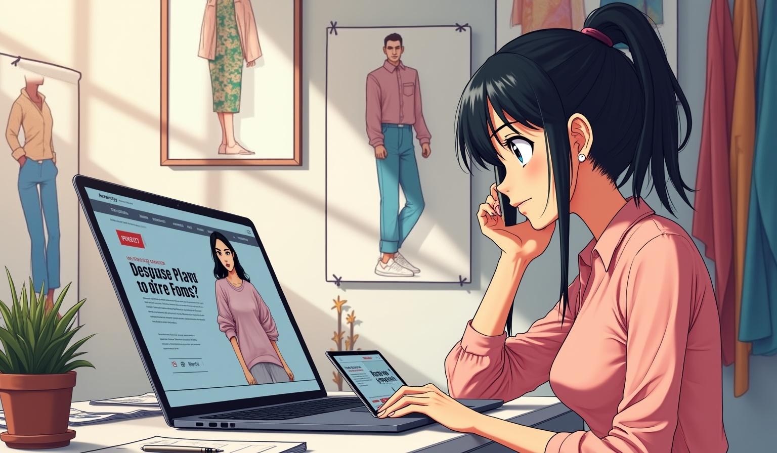
Project Overview
01
XEROX is an e-commerce clothing website built using HTML, CSS, Bootstrap, and Python, aiming to provide a seamless online shopping experience for customers in Pakistan. The website will offer a wide range of clothing products for men, women, and kids, with features like product categorization, search functionality, and secure payment

Slide 4

Problem Statement
The fashion e-commerce market demands websites with smooth navigation, fast load times, and reliable functionality. Many existing platforms struggle with responsiveness and user engagement, causing loss of potential customers. Xerox addresses these challenges by integrating modern web technologies to enhance performance and user satisfaction.

Slide 5
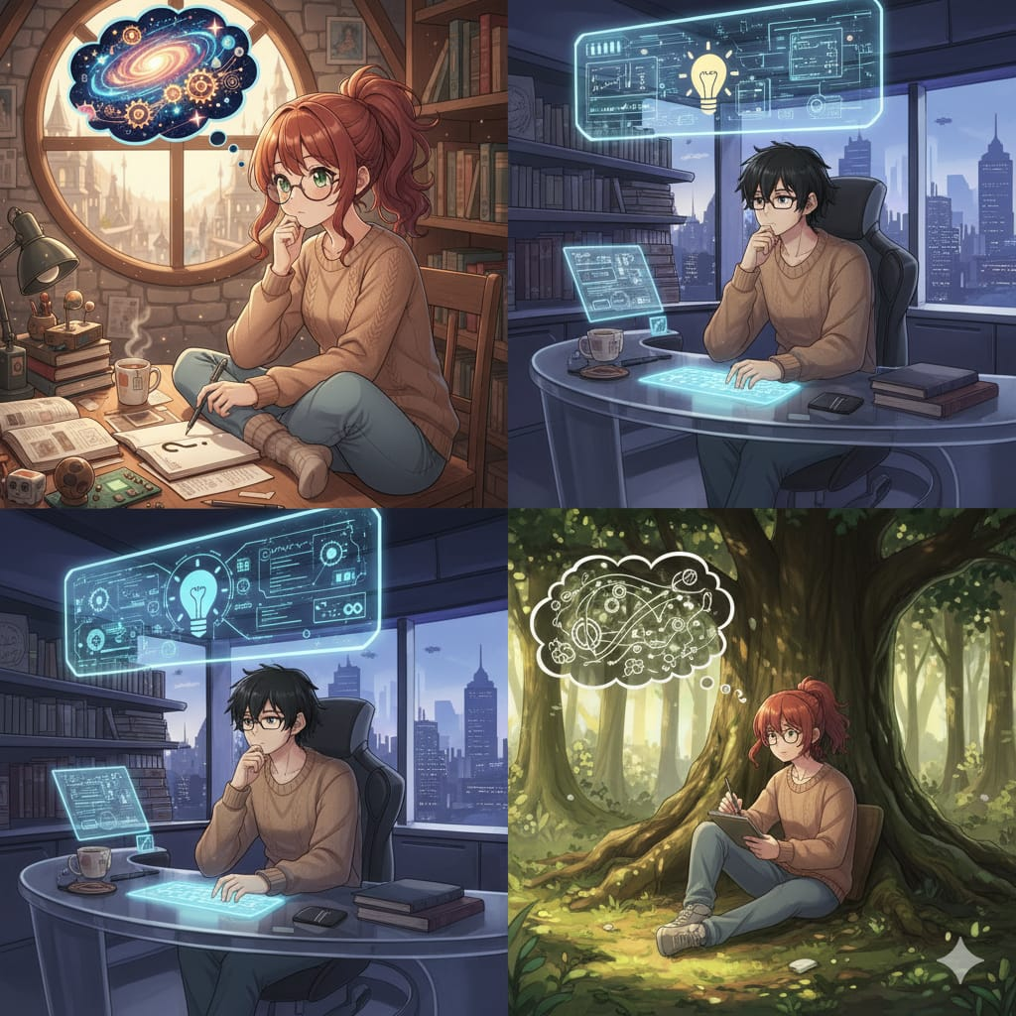
Objectives
The project aims to build a user-friendly, responsive clothing website that supports effortless browsing and secure transactions. It seeks to implement key features like product categorization, real-time search, and a streamlined checkout process to boost customer retention and sales efficiency.

Slide 6
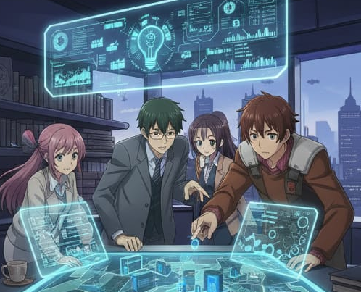
Key Functions
Xerox offers essential features such as a responsive product catalog, advanced search capabilities, secure user authentication, and an efficient shopping cart system. These core functions ensure a smooth user experience and quick access to products, encouraging customer engagement and streamlined order processing. Integration with Bootstrap provides a versatile and mobile-friendly interface.

Slide 7
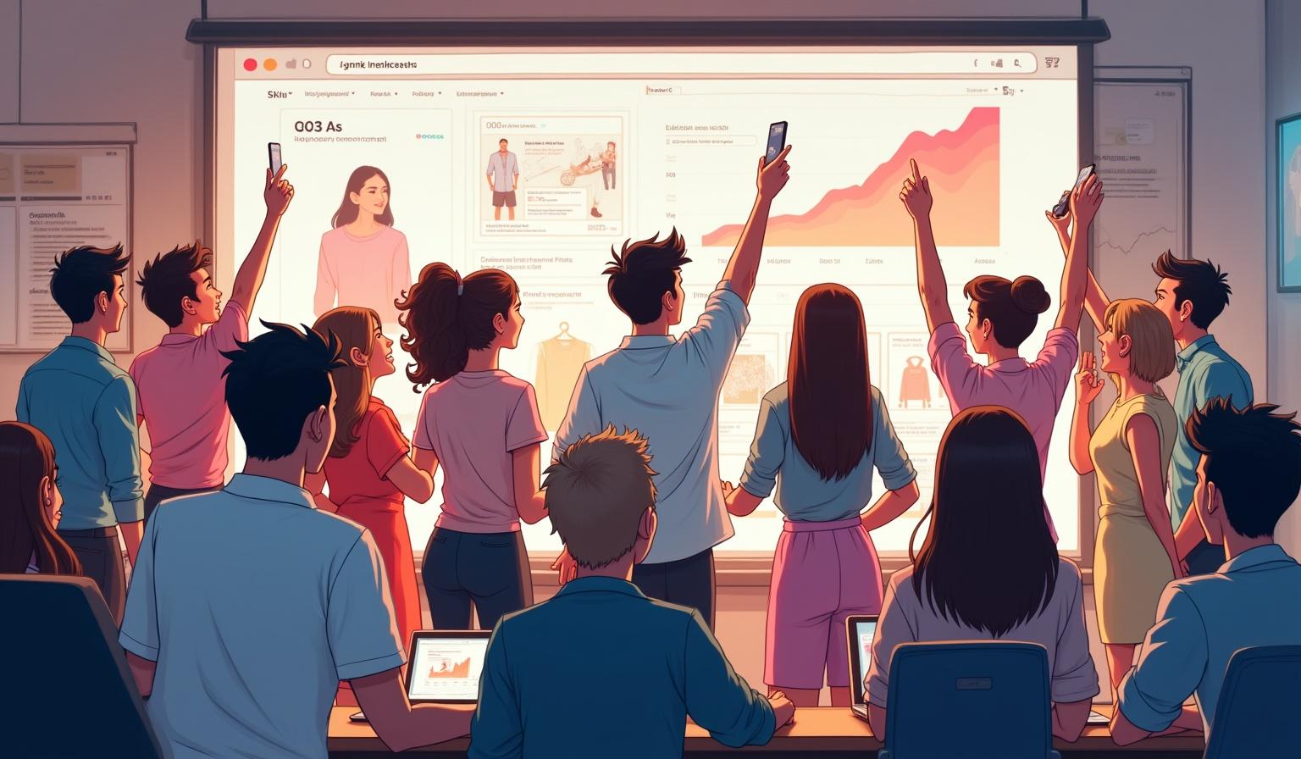
02
Development and Impact

Slide 8
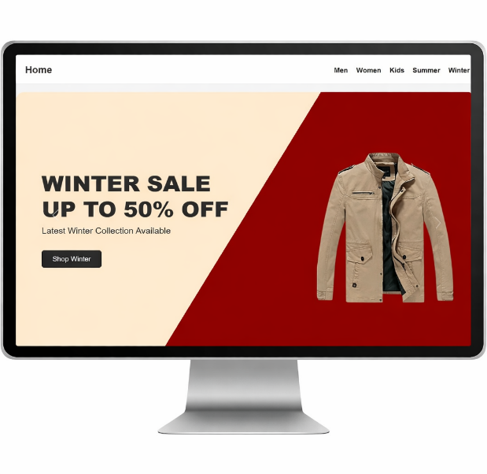
Methodologies
The development process follows an agile methodology, combining iterative design with continuous testing. Technologies like Python for backend logic, HTML and CSS for structure and styling, and Bootstrap for responsive design create a robust framework. Emphasis on modular code and user feedback helps refine features and enhances maintainability.

Slide 9
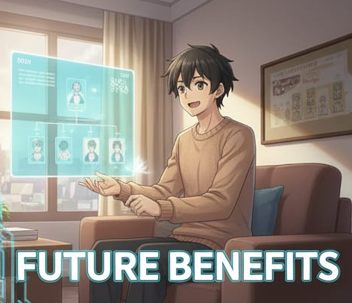
Future Benefits
Xerox’s future enhancements include expanding product varieties, introducing AI-powered recommendations, and incorporating advanced analytics to optimize marketing strategies. These improvements are expected to increase customer retention, improve conversion rates, and foster scalable growth, placing Xerox as a competitive player in the e-commerce apparel industry.

Slide 10
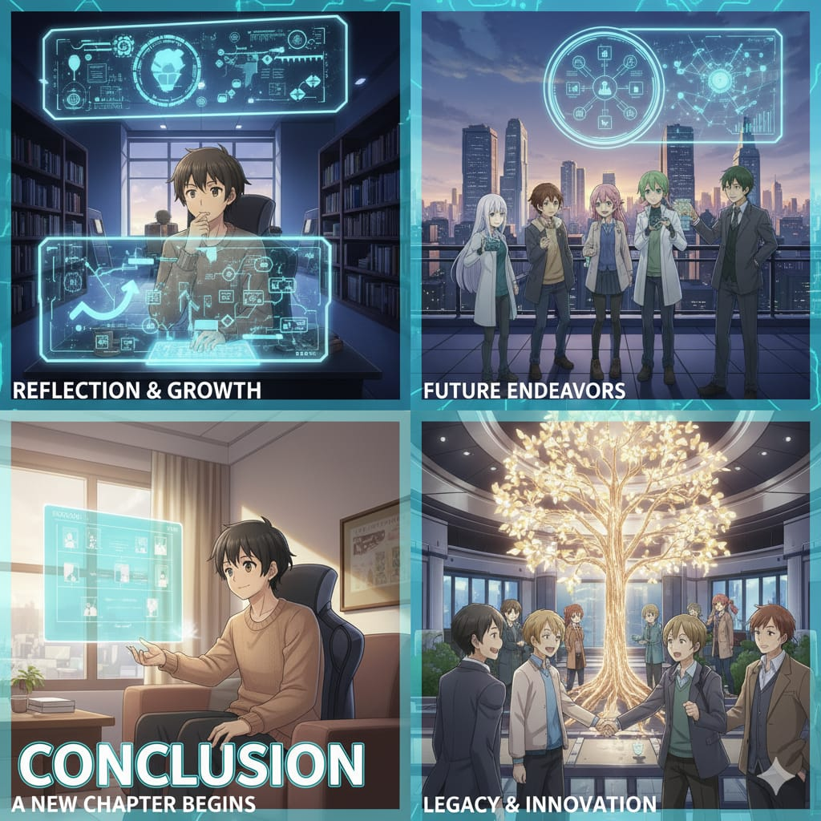
Conclusion
The Xerox website project successfully demonstrates how integrating modern web technologies can solve common e-commerce challenges. With a focus on user experience, responsiveness, and secure functionality, Xerox presents a competitive solution that meets current market demands and accommodates future technological advancements, ensuring sustained business success.

Slide 11
Thank you
Do you have any questions?
xerox8188@gmail.com
http://127.0.0.1:3000/index.html?serverWindowId=b74ba87f-25c3-482e-ace9-c85f53d4f617
SSupervised by :
Mam Taliah
Mam Wagma
Sir Adnan

